Slide 1

NeuroSystems Technologies Pvt. Ltd.
Experts in e-commerce, web development and web graphics

Slide 2
Why NeuroSystems for E-Commerce
3_85
We understand doing E-Commerce is not about building a Website but engaging the customer, building a brand that ultimately convert to sales. E-Commerce is doing business online !
We understand business processes, integration needs, scalability, performance, security & brand building. Building a site is not sufficient, building a brand takes more
Deliver end to end E-Commerce solutions. We can meet all your needs under one roof, yet not fussy about who else we have to work or collaborate with, to realize your objectives
Criticize Web Design to ensure your design is practical and can match your content. Many development companies do not practice due diligence in analyzing the design and later you do not end up with a site you intended.
Optimize and fine tune user experience to increase conversions and revenue
Reduce operation costs by customizing the solution to existing business processes, thereby also reducing man power costs by focusing on automation and productivity

Slide 3
Why NeuroSystems for E-Commerce
3_85
Not limited by existing technical platforms or solutions as we have a custom built platform that has served our customers over the years. There is no limit to what we can offer, so your growth needs are secure
Most companies use open source solutions where you would have additional licensing costs for enterprise solutions. Furthermore additional plugin’s and capabilities cost more on a retainer basis as opposed to a one time fixed cost per feature. All this adds pressure to your infrastructure, man power, user experience and operation costs can spiral out of control without you having any way back. We discarded this approach many years back as it prevented us from offering our customers the solutions they needed. We can do what you need, when you need and exactly how you want it !
Proven track record of Zero critical defects backed by a Warranty
Your organization will be in complete control of your data, content & operations, without needing any specialized platform technicians to operate it

Slide 4
Why NeuroSystems (Work Ethics)
3_85
Your success is our success
The people who are the face of the company are also industry recognized solution specialists, so you can be assured there is no marketing Bull Shit !
We talk facts, numbers and experience. No promises, only written contracts and commitment to what we say we will deliver, ….and we do deliver !
Give personalized attention to all our clients, while being professional and objective
We have worked with enterprise to small businesses. We know what solution works where and when
We understand the cost of re-doing something. We ensure we get it right the first time and also guide our clients in doing the right thing the first time
Transparent, Innovative, Honest and attention to detail
Any of our claims can be verified by any of our existing clients

Slide 5
Full suite of products & services
Web solutions
Website design & user experience | Technology partner to leading website designers in India, bringing together creative and technical aspects that enable superior user experience on the web
Website development | Implementing web design, to create static or dynamic websites, with full array of optional custom functionalities
E-Commerce & Business Process customization | End-to-end portal and ecommerce site development, with integrations such as payment gateway and cloud services etc. Include: Powerful and flexible Search, Tracking, Orders & Invoicing, Advanced Cart features, Flexible Reporting, Promotions & Discounts, Mailing using customized templates and more.
Web security consulting | Expertise in protecting websites and applications on the web against hackers
Web service development | Services on websites to enable mobile application development
Website hosting | Manage entire website set-up including hosting through third-party infrastructure providers
Document, Data management & image processing | Allow centralized repository of document versioning and workflow management
Specific Business application development | Create custom business solutions to fulfill a specific need (eg. creating an invoicing system, partnership incentive model, custom development on salesforce.com etc)
E-Marketing | Technology partner to leading social media and web marketing experts that can help attract higher traffic; bulk promotions mailers and newsletters. We can also help you with your Social Media strategy, Content writing, PR and more.
Cloud development with Amazon, SalesForce, Google | Leverage existing cloud services that a business may have purchased, to deliver custom business solutions
Business services

Slide 6






About NeuroSystems
3_85
Founded in winter 2009 by Arjun Dhar in New Delhi, India
  Specialize in Web Development and E-Commerce; we also experiment and research with new concepts
  Additional synergy with partner companies who specialize in Concept Design, PR and marketing
Aim on providing end-to-end service to customers, with single point of contact (see products & services)
Help includes all IT aspects related to hosting, performance, security, consulting etc. for the website
Focus on continuous innovation & learning, sharing experiences, best practices
Focus on delivering sustainable solutions that result in low long term costs and higher yield
Over Ten end-to-end projects successfully delivered
Strong belief in Work ethics. Only promise what one can commit to and build long term relations which assert Trust
Believe in providing personal attention to customer needs
We promote a disciplined & dedicated work ethic that is yet informal and innovative
Never shy of sharing our honest opinions with our customers
Some of
Our clients

Slide 7
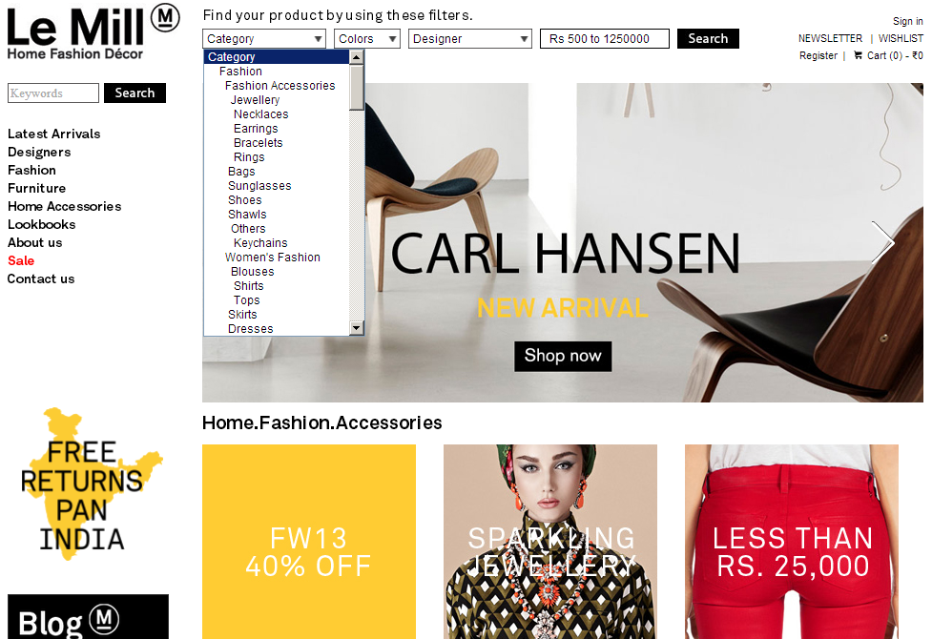
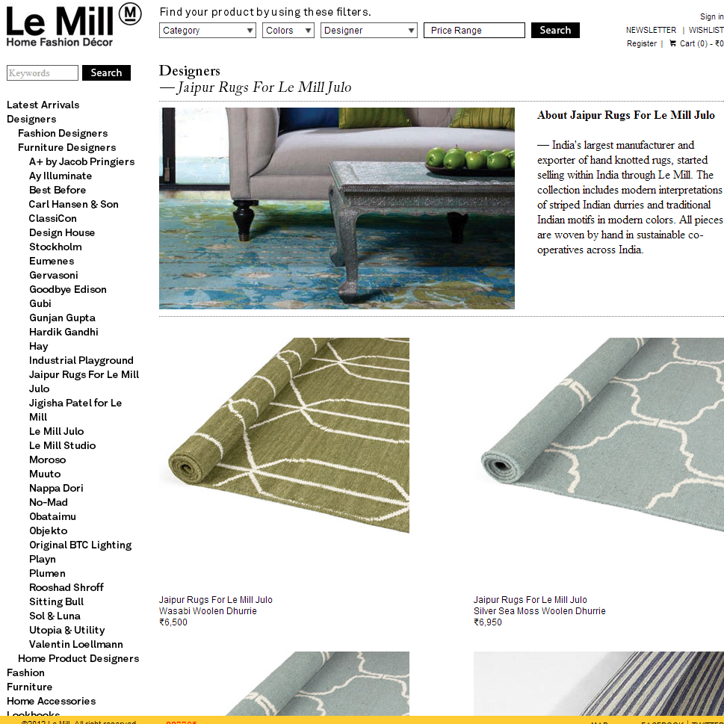
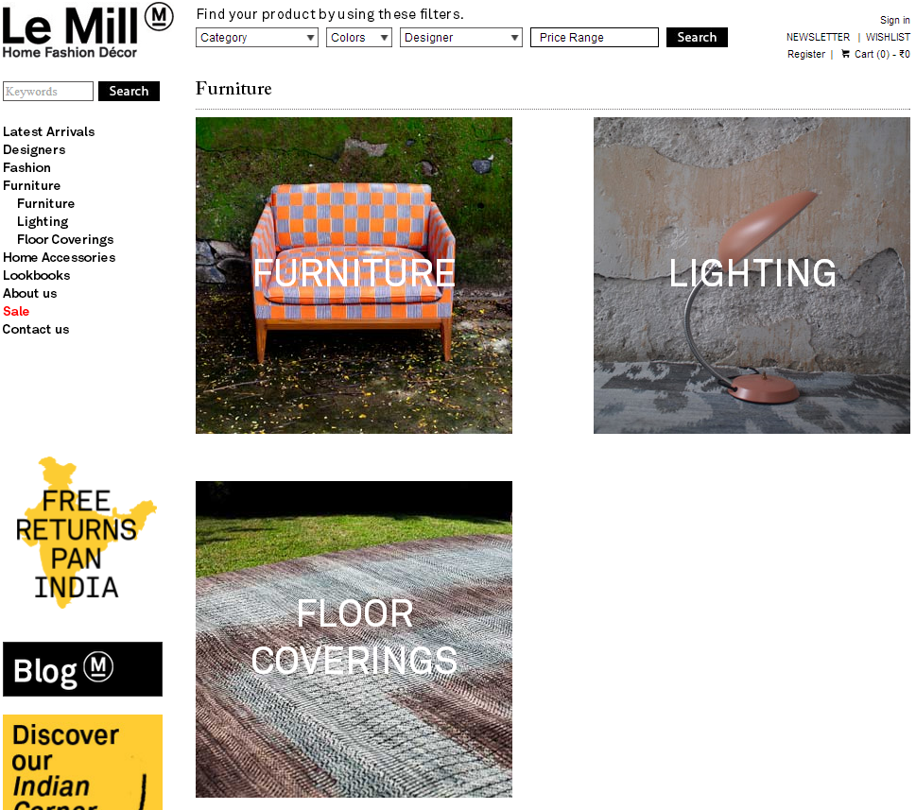
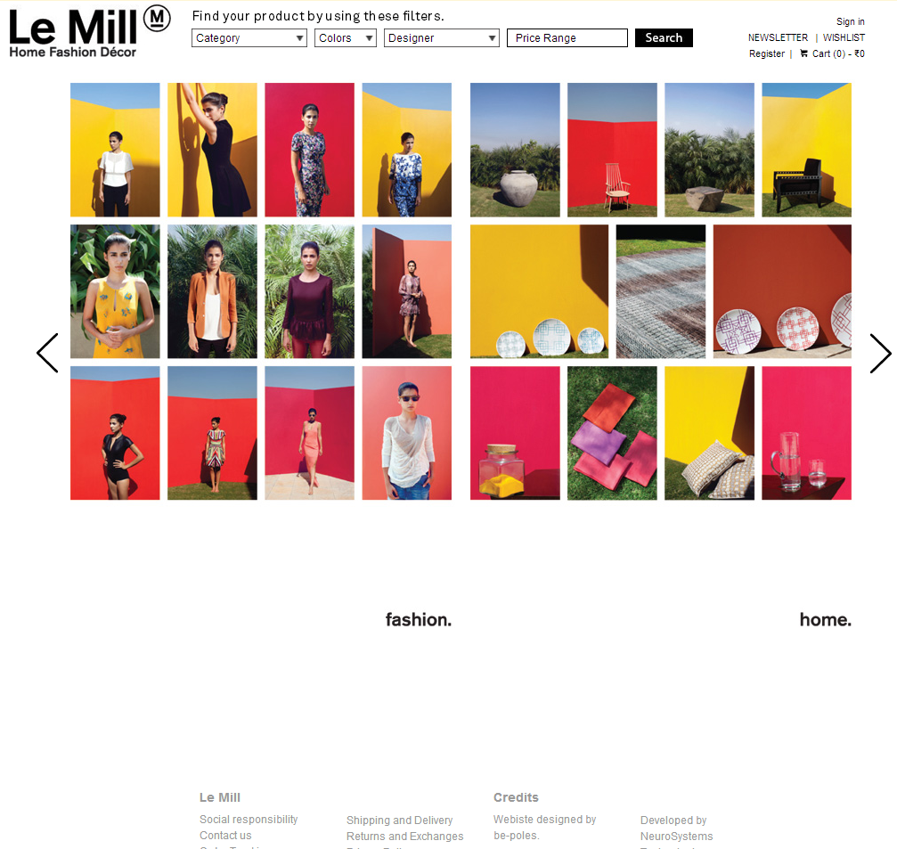
4_85
https://www.lemillindia.com
E-Commerce for Multi Brand Luxury Fashion and Furniture Designers
Powerful Search abilities, News letters
Just requires one non technical person to manage the entire site; including content, catalogue, orders; thanks to our simple to use proprietary technology
Ability to create & execute online Spot marketing Campaigns within hours
Ability to change complex Shipping policies, Discount policies, Sale policies, Payment Option policies, Tax policies with confidence
Once a feature is tested & delivered , it requires no dependence on a programmer thereby allowing business direct control which helps in reduce TIME & COST to market or change strategies
Focus on Automation and less manual interference : CMS, Direct automation, Catalog System, ETL and more…

Slide 8
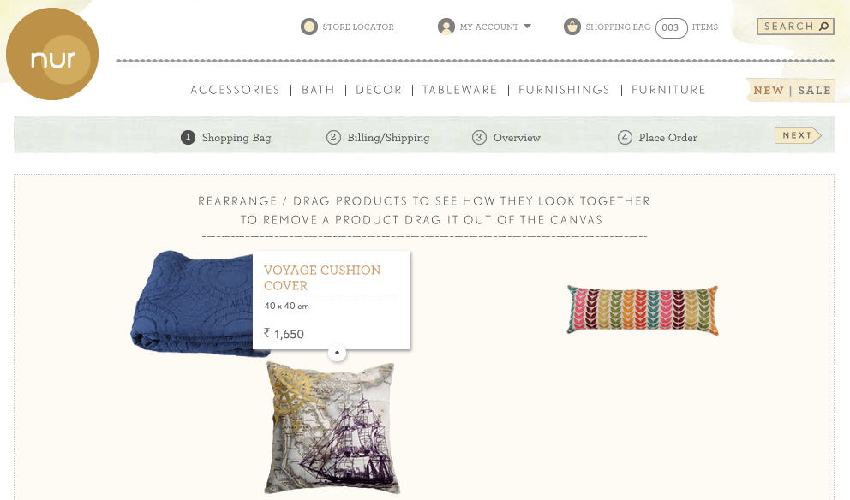
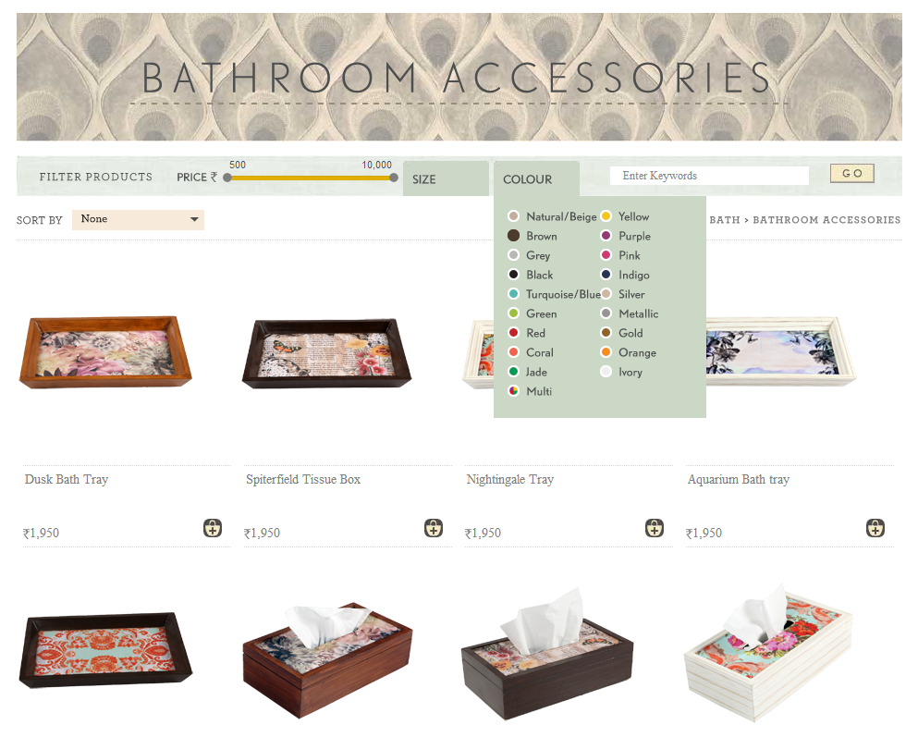
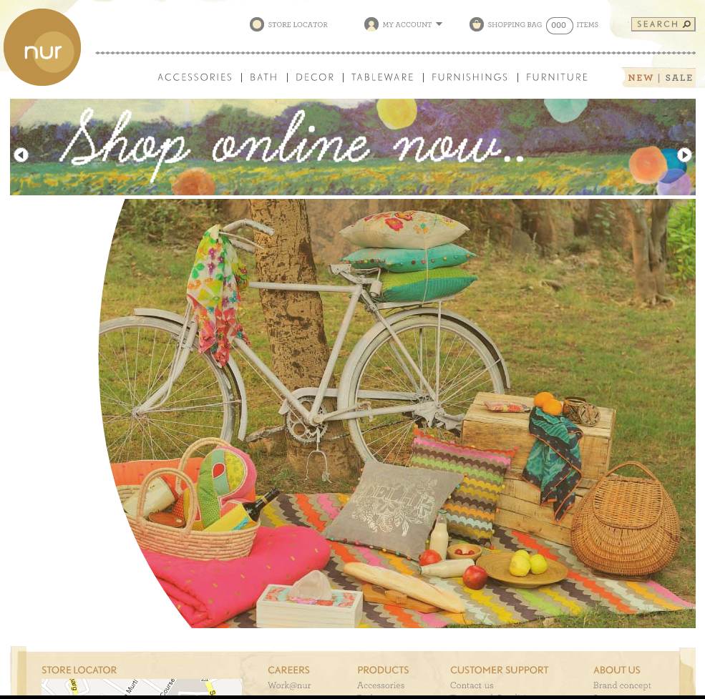
4_85
https://www.nurhome.in
E-Commerce for Multi Brand Home Furnishings Export
NON-FLASH based Animation on Home Page that allows business user to change pictures within Animation without programming
Dynamic & Visually interactive pages
Powerful Search abilities customized per category
No technical staff required to manage site
Drag and compare Visual Shopping Cart (No site in the world has this)
Ability to change complex Shipping policies, Discount policies, Sale policies, Payment Option policies, Tax policies with confidence
Focus on Automation and less manual interference : CMS, Direct automation, Catalog System, ETL and more…

Slide 9

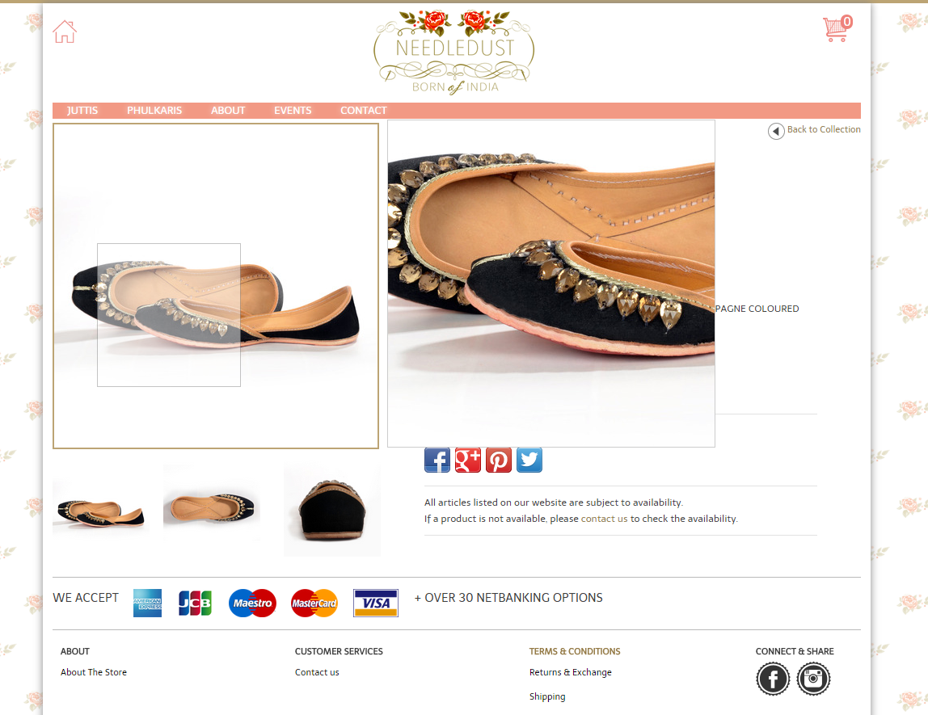
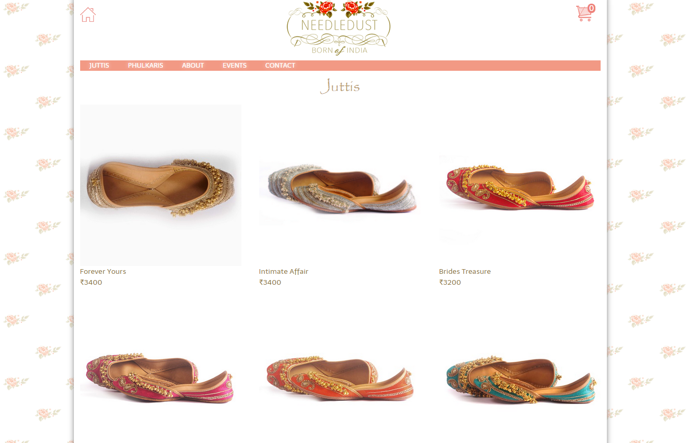
4_85
http://www.needledust.com
E-Commerce for lower budget
Aimed purely for SALE and quick user experience
Design and User Experience was done by us end to end
No technical staff required to manage site. Site is run by 1 person who is also handing the business
Focus on Automation and less manual interference : CMS, Direct automation, Catalog System, ETL and more…

Slide 10
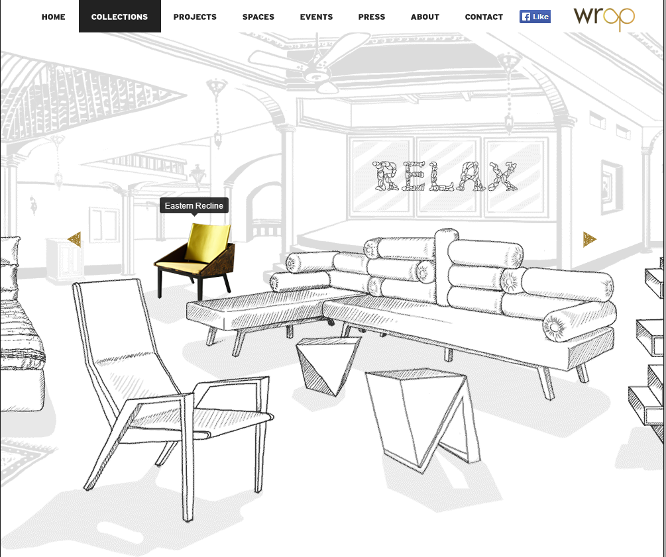

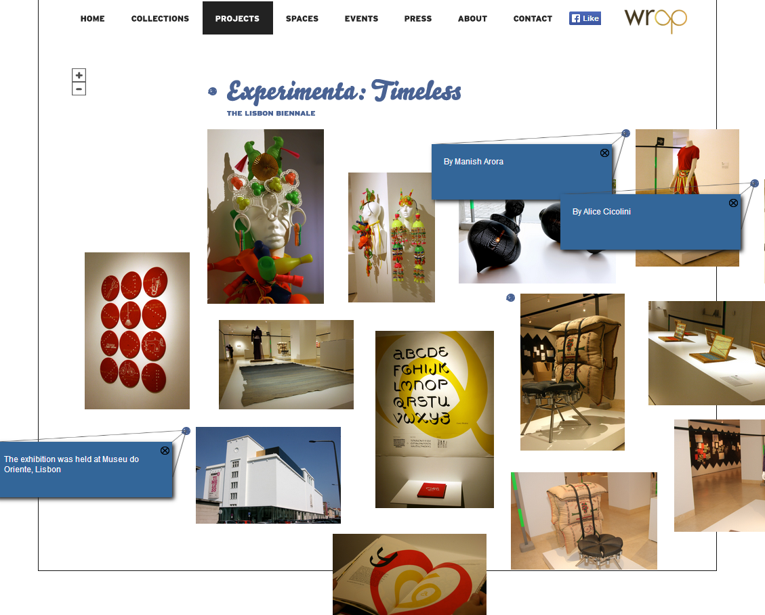
4_85
http://wrap.co.in
Brand identity and Product catalogue for Design Company
Each page on Site has a unique design concept
Home page background image changes each time you visit the site
NON Flash based visually interactive pages
Has a very visually appealing and interactive PRESS, Events page
Example:
On the collections page on the website, one can interact with their Products in 3D.
On interaction the object comes to life in colour
Map like concept of all the projects; you can Zoom in/out & interact with them

Slide 11

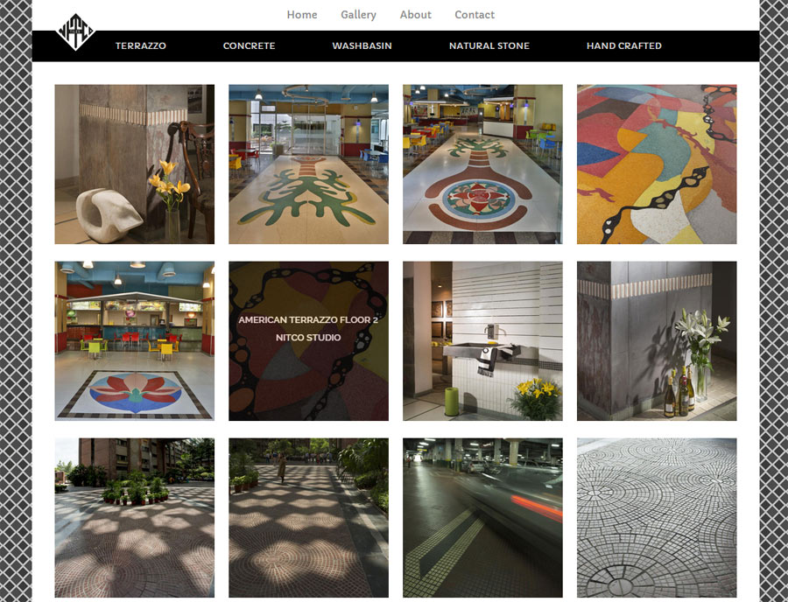
4_85
Nitco Tiles @ http://106.187.93.229/nitco/gallery.jsp
Brand identity and Product catalogue for well known Tile Company
Each category has a different theme.
NON Flash based visually interactive pages
Managed by a catalog system and backend doing all the image and data heavy lifting

Slide 12

4_85
http://avasara.in
Corporate Site CMS based for an NGO promoting girl child education

Slide 13


… and more
3_85
Digital marketing Services
Catalogue Sites
Research projects
Incubation Projects
Consulting Projects
Startup Projects

Slide 14
Website links
Site: Le Mill E-Commerce
https://lemillindia.com/
Pages on site
https://lemillindia.com/home.jsp
https://www.lemillindia.com/designer.jsp?name=3.1%20Phillip%20Lim
https://lemillindia.com/lookBooks.jsp
https://www.lemillindia.com/lookBook.jsp?name=FW14+LOOKBOOK
Site: Nur
https://nurhome.in/
Pages on site
https://www.nurhome.in/nur/category.jsp?name=Furnishings
https://www.nurhome.in/nur/catalog.jsp?name=Cushions
https://www.nurhome.in/nur/press.jsp
http://www.nurhome.in/shop-1-bag.jsp (Interactive Shopping Cart - Custom Built. Add products to cart, and play with the cart items)
Add some products and add to Cart -- No site in the World has a Shopping Cart like this and was developed from scratch by us
http://wrap.co.in/
Pages on site
http://wrap.co.in/collections.html - Interact with various Products on the Scene
http://wrap.co.in/events.html
http://www.wrap.co.in/projects/experimenta.html
Other sites:
http://avasara.in/
http://www.invictusoncology.com/
http://trueso.co.in/

